Slide 1









XX-EU Business Forum
EU REGIONAL BUSINESS FORUM
Investments on the Abidjan-Lagos and Abidjan-Ouagadougou corridors (Côte d'Ivoire, Bénin, Burkina Faso, Ghana, Nigéria, Togo)
Abidjan
30 Mars – 01 Avril 2026

Slide 2



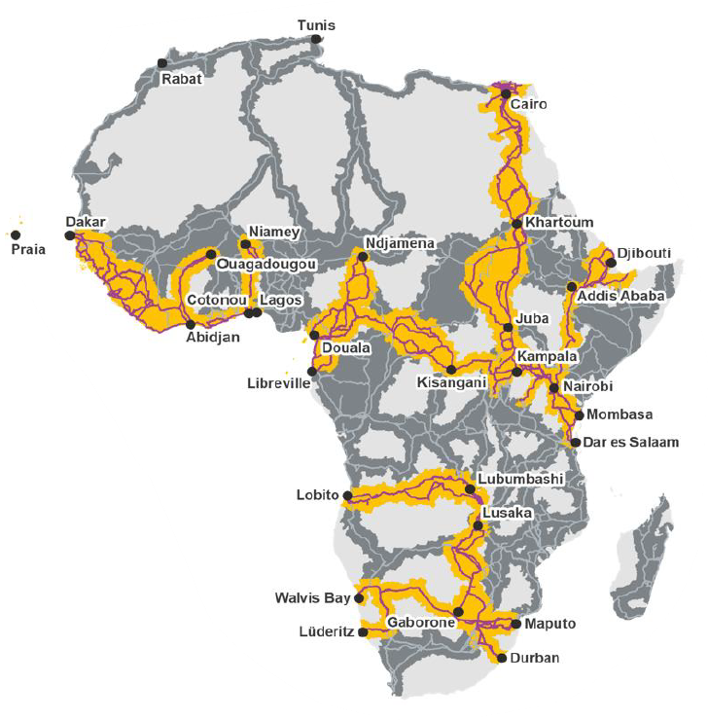



Introduction
Financement :
Coordination de projet :
Budget : 45,3 millions €
Project HQ : Abidjan, Côte d’Ivoire
Abidjan-Lagos : 1,028 km
Abidjan-Ouagadougou: 1,263 km
3 piliers :
A. Coordination and corridor management
B. Transport Facilitation
C. Exchange and commerce facilitation

Slide 3






EU-Regional Business Forum
30 Mars -01 Avril 2026
Abidjan
500-800 pers.
Website INTPA launched
Registration : open in January 2026, on the EABF platform
Co-organised with EU-Africa Business Forum Facility

Slide 4



EU-Regional Business Forum : Objectifs
Promote regional political and economic dialogue on topics related to transport and corridor management.
Promote a portfolio of priority corridor projects (project pipeline) to private companies and European financial institutions.
Promote, within a project financing structuring approach, priority projects both at the national level and at the corridor level (covering at least two countries)

Slide 5
EU- Regional Business Forum:
Sectors
Transports
Ports
Security, safety and decongestion
Corridors
Logistics
Sustainable urban Mobility
Road transport
Road maintenance fund
PPP (Public-Private Partnership)
Rail transport
Training
Digitalization
Dry ports
Lagoon freight
Weigh stations
Lagoon mobility
Intelligent Transport Sytems
Electric Mobility
Operational Support and Passenger Information Systems

Slide 6

Regional Business Forum: Activities
Live event, 3 whole days
High level opening ceremony
Participants
Private Sector : EU + local and regional
Public Sector : EU + local and regional
Other: financial institutions, etc.
Sectors
Activities:
Thematic panels
Exposition stands
Networking Sessions B2B / B2G
Networking Lunch
Project pitching Sessions
Workshop on current reforms
Field visits
Transport & Logistics
Digital Transformation

Slide 7
Regional Business Forum : Agenda
DAY 01
DAY 02
DAY 03
Opening Ceremony
Field visit
Project Pitching
(B2F ; G2B ; G2F)
Expositions
Matchmaking
Panel Maritime Transport
Panel Corridors and regional integration
MORNING
Global Gateway
Project Pitching
Project Pitching
360° Corridor investment overview
Dialogue PPP
B2F Clinic
Panel Road Transport
Panel Railway Transport
Panel Investments and financing
Panel Smart Mobility and Digitalisation
Clinics
Public-Private Dialogue
AFTERNOON
B2G Clinic
B2G Speeddating
Signing ceremony
Networking cocktail
Closing ceremony
Cocktail de cloture

Slide 8
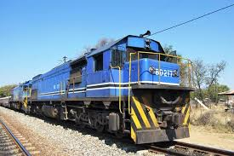





Gouvernance
Steering Committee:
Lead:
  EU Delegation Côte d'Ivoire
  Ministère des Transports Côte D'Ivoire
Members:
  Enabel
  Expertise France
  TMA

Slide 9
Project pipeline
5 sectors :
  Road Transport
  Railway Transport
  Port Infrastructure (dry and maritime)
  Logistics platforms / industrial zones
  Digitalization (trade procedures, security, etc.)
  Chain of value
Project sourcing
Integrated national offer
Industry Champions

